Slide 1

Natural Language Processing Course Word2Vec
Ivo Bernardo – Udemy Course

Slide 2
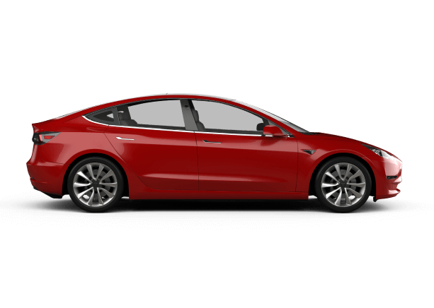
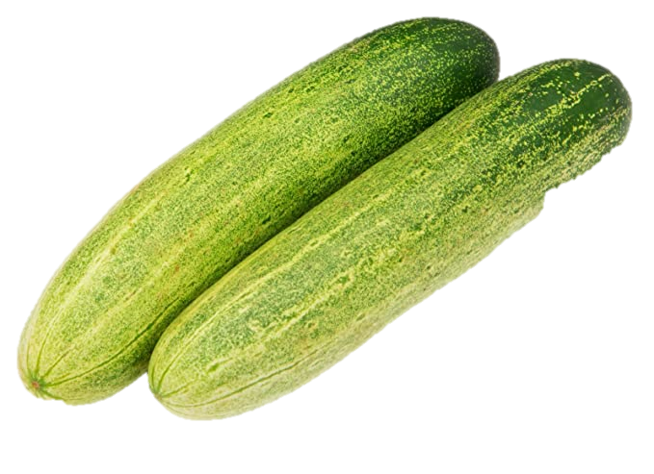
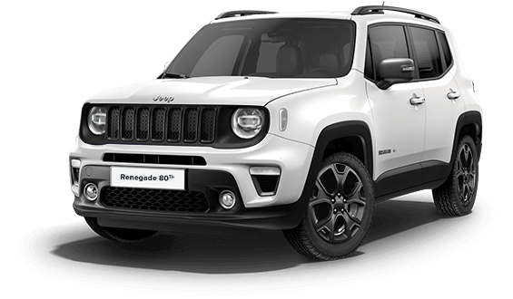
Word Vectors Intuition – Co-Occurence Matrices
These representations of words are what we commonly call Word Vectors!
a
1
ate
1
drive
1

Slide 3
Word Vectors Intuition – word2vec Model
1
[?, ?, ?]
[?, ?, ?]
[?, ?, ?]
1
1

Slide 4
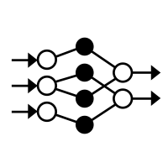



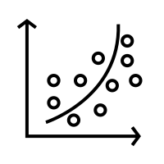
Word Vectors Intuition – Machine Learning Models

Slide 5




Word Vectors Intuition – Machine Learning Models

Slide 6

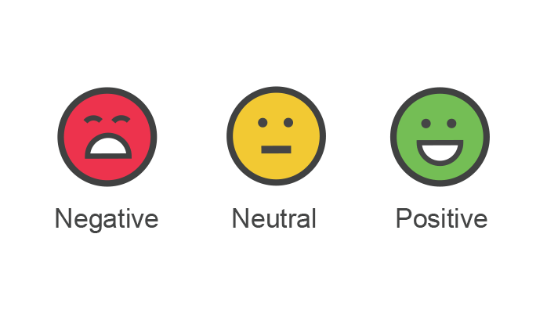
Word Vectors Intuition – Text Classification

Slide 7
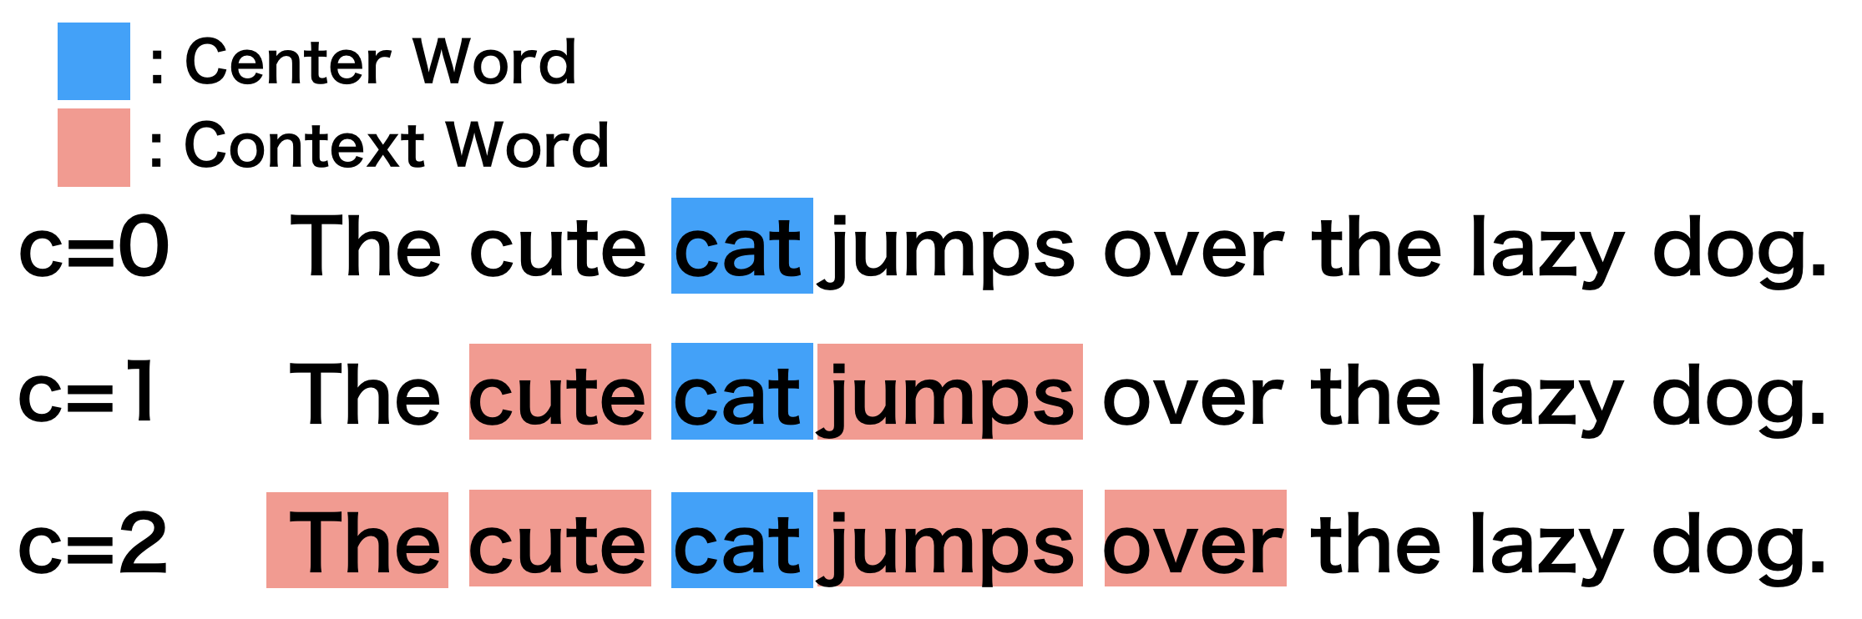
Word Vectors Intuition – Word2Vec – CBOW Architecture
https://docs.chainer.org/en/latest/examples/word2vec.html

Slide 8
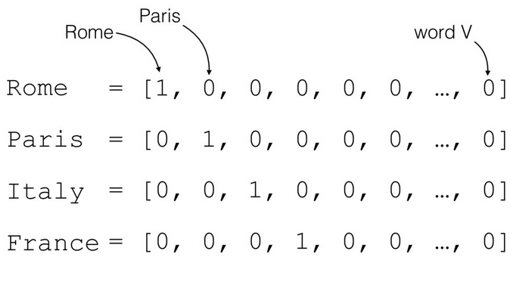

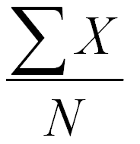
Word Vectors Intuition – Word2Vec
https://docs.chainer.org/en/latest/examples/word2vec.html

Slide 9
Word Vectors Intuition – Word2Vec – CBOW Architecture
https://docs.chainer.org/en/latest/examples/word2vec.html

Slide 10
Word Vectors Intuition – Word2Vec – CBOW Architecture
https://docs.chainer.org/en/latest/examples/word2vec.html

Slide 11
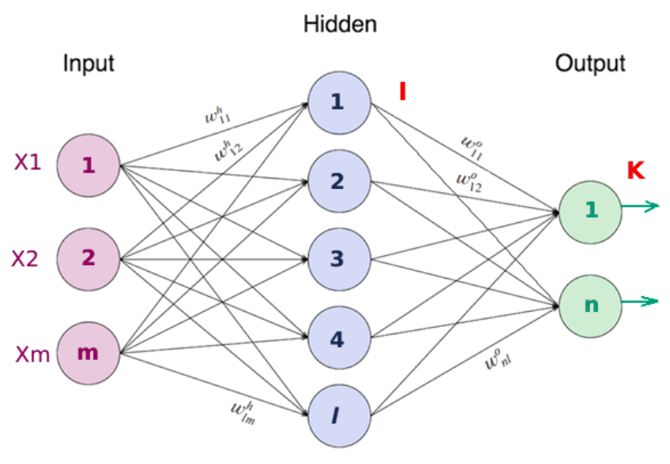
Word Vectors Intuition – Word2Vec – Neural Networks
https://medium.com/swlh/neural-networks-4b6f719f9d75

Slide 12

Neural Networks – Using a Bank Loan Default Example
Age
X1
H1
Y
Default
X2
H2
Income

Slide 13

Neural Networks – Using a Bank Loan Default Example
Age
Age: 64
Age: 61
Income: 30
Income 60
Age: 20
Age: 21
Defaulted = 1
Income: 30
Income 60
Did not Default = 0
Income

Slide 14
Neural Networks – Starting with Random Weights (Ignoring Bias Term)
X1
W11
H1
Age
H11
W12
Y
Default
W21
X2
H2
Income
H21
W22

Slide 15
Neural Networks – Starting with Random Weights (Ignoring Bias Term)
X1
W11
H1
Age
H11
W12
Y
Default
W21
X2
H2
NN Weights:
Income
H21
W22
W11 = 0.5
W12 = 0.5
W21 = 0.5
W22 = 0.5
H11 = 0.8
H21 = 0.2

Slide 16
Neural Networks – Starting with Random Weights (Ignoring Bias Term)
X1
0.5
H1
Age
0.5
0.5
Y
Default
0.5
X2
H2
Income
0.5
0.5
Age: 64
Income: 30

Slide 17

Neural Networks – Starting with Random Weights (Ignoring Bias Term)
0.5*64 + 0.5*30
X1
0.5
H1
Age
0.8
0.5
Y
Default
0.5
X2
H2
Income
0.2
0.5
0.5*64 + 0.5*30
Age: 64
Income: 30

Slide 18

Neural Networks – Starting with Random Weights (Ignoring Bias Term)
47
47
X1
0.5
H1
Age
0.8
0.5
Y
Default
0.5
X2
H2
Income
0.2
0.5
47
47
Age: 64
Income: 30

Slide 19
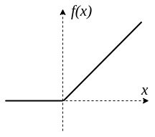
Neural Networks – Zooming In on ReLu Function
0

Slide 20
Neural Networks – Starting with Random Weights (Ignoring Bias Term)
47
Age
X1
0.5
H1
0.8
47*0.8+47*0.2 = 47
0.5
Y
Default
0.5
X2
H2
Income
0.2
0.5
47
Age: 64
Income: 30

Slide 21
Neural Networks – Starting with Random Weights (Ignoring Bias Term)
47
Age
X1
0.5
H1
0.8
47
~1
0.5
Y
0.5
X2
H2
Default
Income
0.2
0.5
47
Age: 64
Income: 30

Slide 22
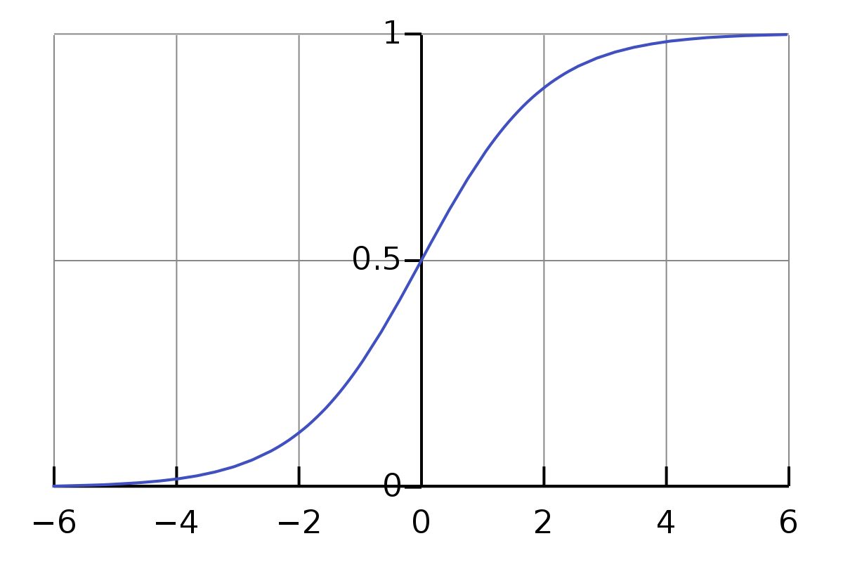
Neural Networks – Zooming In on Sigmoid Function

Slide 23
Neural Networks – Starting with Random Weights (Ignoring Bias Term)
47
Age
X1
0.5
H1
0.8
47
~1
0.5
Y
Our algorithm is correct, no need to adjust the weights!
0.5
X2
H2
Default
Income
0.2
0.5
47
Age: 64
Income: 30

Slide 24
Neural Networks – Moving on to the next example!
X1
0.5
H1
Age
0.5
0.5
Y
Not Default
0.5
X2
H2
Income
0.5
0.5
Age: 20
Income: 30

Slide 25
Neural Networks – Starting with Random Weights (Ignoring Bias Term)
25
Age
X1
0.5
H1
0.8
25
~1
0.5
Y
Our algorithm is incorrect!
We need to adjust the weights!
0.5
X2
H2
Not Default
Income
0.2
0.5
25
Age: 20
Income: 30

Slide 26
Neural Networks – Starting with Random Weights (Ignoring Bias Term)
25
Changing this weight
Age
X1
0.5
H1
-0.8
?
?
0.5
Y
0.5
X2
H2
Not Default
Income
0.2
0.5
25
Age: 20
Income: 30

Slide 27
Neural Networks – Starting with Random Weights (Ignoring Bias Term)
25
Age
X1
0.5
H1
-0.8
-19.5
~0
0.5
Y
Our algorithm is correct!
0.5
X2
H2
Not Default
Income
0.2
0.5
25
Age: 20
Income: 30

Slide 28
Neural Networks – Starting with Random Weights (Ignoring Bias Term)
We keep doing this process until we have an optimal weight matrix that can guess our customers’ loan default scenario, correctly.

Slide 29
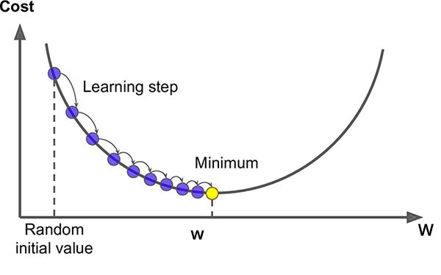
Word Vectors Intuition – Word2Vec – Gradient Descent
https://morioh.com/p/15c995420be6

Slide 30
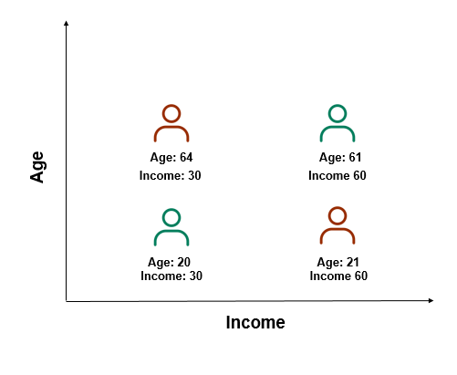
Neural Networks – Checking Performance of Best Neural Network – Using one Example
Bias term (special NN term)
-14.52+14.72-0.19 ~= 0.0003 -> RELU -> 0.0003
Bias term (special NN term)
Age
X1
-0.72
H1
1.21
~0-5.11+1.15 = -3.94
~0.02
-0.31
Y
Our algorithm is correct!
0.49
X2
H2
Not Default
Income
-0.37
-0.67
-6.37+20.08+0.14= 13.85 -> RELU -> 13.85
Bias term (special NN term)
Age: 20
Income: 30

Slide 31
Neural Networks – Checking Performance of Best Neural Network – Using one Example
Bias term (special NN term)
-46.47+14.71-0.19 ~= -31.95 -> RELU -> 0
Bias term (special NN term)
Age
X1
-0.72
H1
1.21
0+0+1.15 = 1.15
~0.76
-0.31
Y
Our algorithm is correct!
0.49
X2
H2
Default
Income
-0.37
-0.67
-20.37+20.07+0.14= -0.15 -> RELU -> 0
Bias term (special NN term)
Age: 64
Income: 30

Slide 32
Word Vectors Intuition – word2vec Model
Weights from Neural Network!
1
[0.5, 0, 0.5]
[0.3, 0, 0.3]
[0, 1, 0]
1
1

Slide 33
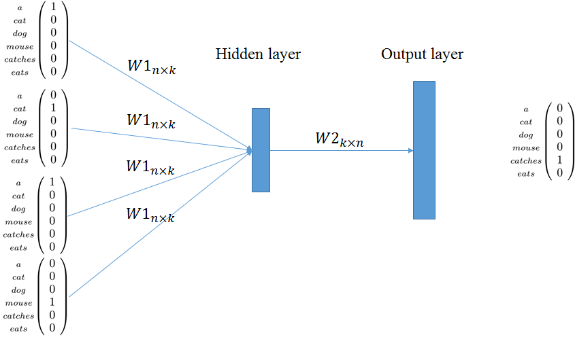
Word Vectors Intuition – word2vec Model - Summary

Slide 34
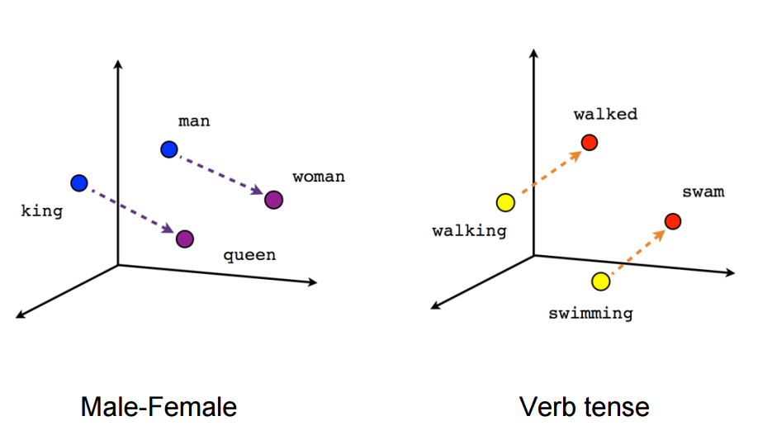
Word Vectors Intuition – word2vec Model - Analogies
https://www.urdunlp.com/2019/08/how-to-build-word-2-vector-for-urdu.html

Slide 35
Word Vectors Intuition – word2vec Model
Really good for Analogies
Conveys the relationship between the context words and the center word
May take a lot to run and train the Neural
Network
Least similar words (using similarity) are not very interpretable

